Slide 1
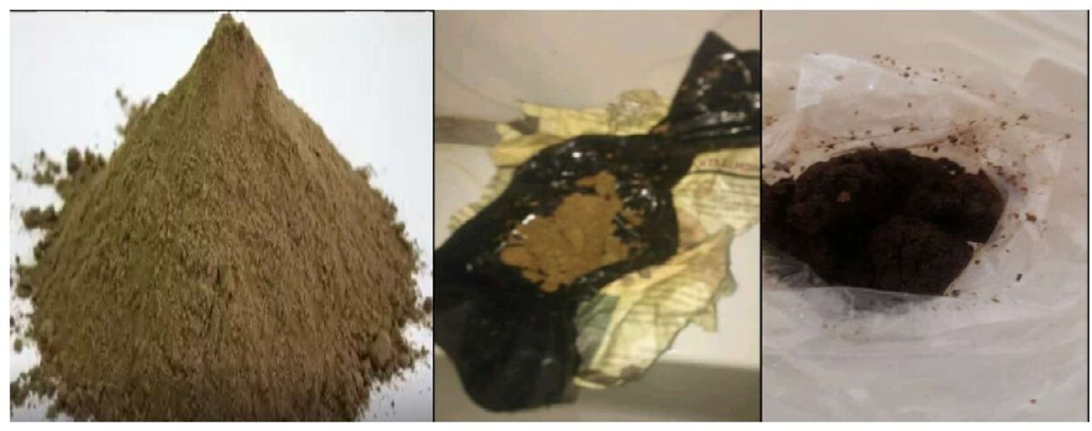

Sample of ‘taba’/vaginal tobacco (photo credit: Mothers’ Health Foundation, The Gambia).
Bai Cham et al. Tob Control doi:10.1136/tc-2022-057831
©2023 by BMJ Publishing Group Ltd
Notes:
Sample of ‘taba’/vaginal tobacco (photo credit: Mothers’ Health Foundation, The Gambia).

